Slide 1
Hikayat Rekayasa Balik
Journey of Reverse Engineering

Slide 2
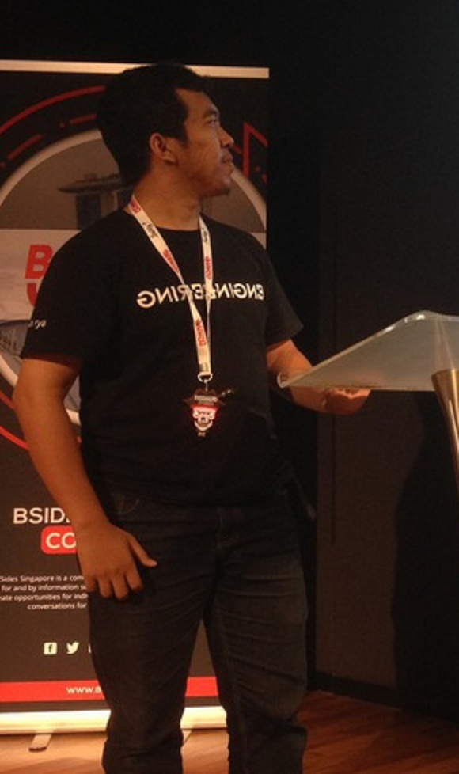



Who?
Satria Ady Pradana
Lead of Cyber Operation at Archonlabs
Penetration Tester, Red Team
Community Leader of Reversing.ID
@xathrya
xathrya
xathrya_

Slide 3
Hakikat Reversing
Ragam Praktik
Reversing & Cyber Security
Karir?

Slide 4
Hakikat Reversing

Slide 5
Reversing itu …
Cracking?

Slide 6
Reverse Engineering
Bermain-main dengan sesuatu yang belum diketahui
Memecahkan misteri
Mempelajari bagaimana sesuatu bekerja
Memodifikasi maupun menghasilkan sesuatu dari pengetahuan yang didapat.
“Art and science of understanding the mechanics of man-made creation, extracting the design, and recreate anything based on the knowledge”

Slide 7
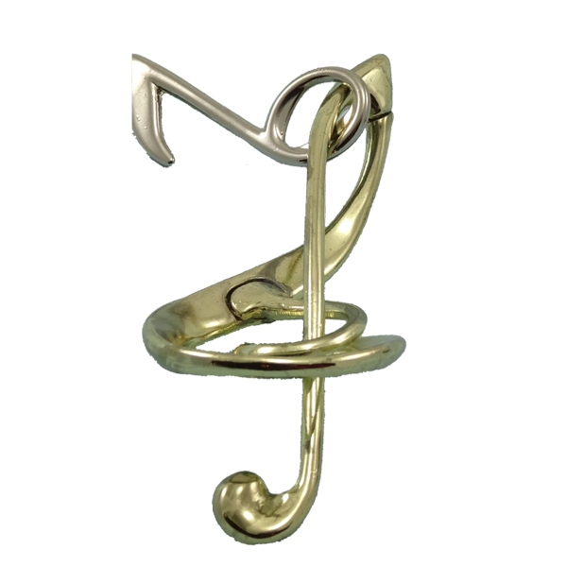
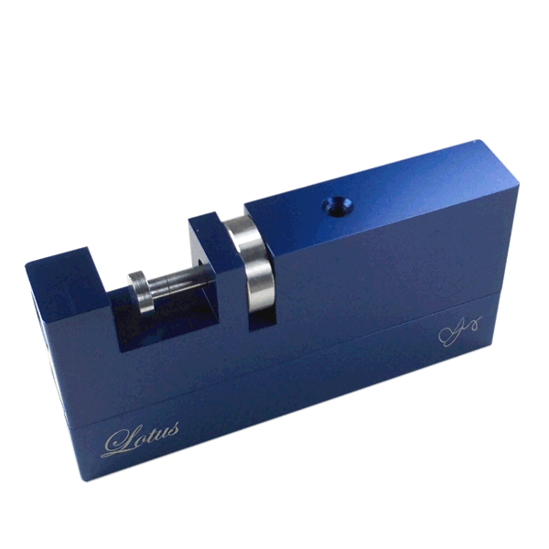
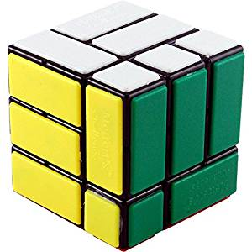
SEPERTI PUZZLE

Slide 8

Artinya?
Berpikir kreatif.
Terus menerus belajar hal yang baru.
Tertantang untuk memecahkan masalah.
Sangat mungkin memakan waktu yang tak sedikit.

Slide 9
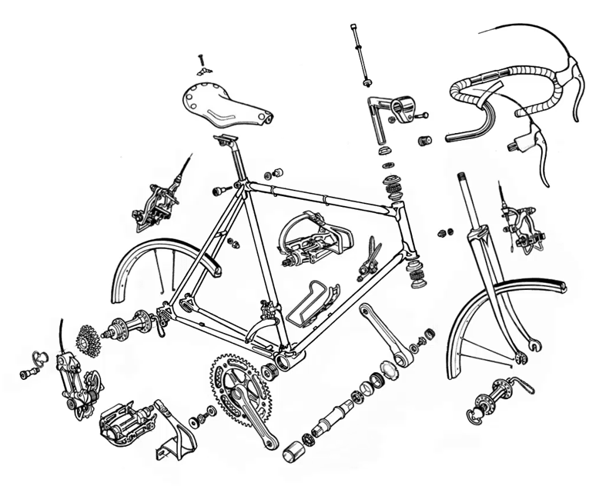

Slide 10

Motivasi
Interfacing
Improve documentation shortcomings
Bug Fixing
Creation of unlicensed duplicates
Repurposing
Finding security bugs

Slide 11
Developer vs Reverser
Reverser dan Developer sering bersaing satu sama lain.
Developer ingin melindungi kekayaan intelektualnya.
Reverser ingin memecahkannya.
Siapa yang tertawa di akhir?

Slide 12
Reversing itu Luas!
Software
Hardware
Protocol
Data Format

Slide 13
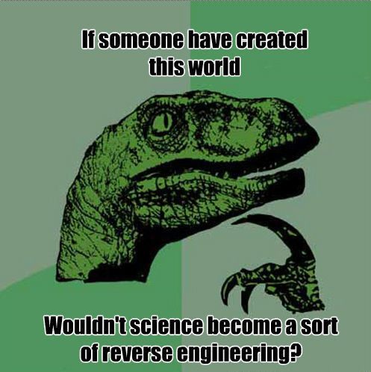

Slide 14
Ragam Praktik

Slide 15
Binary Analysis
analisis kode secara statis dan dinamis
Disassembly
Decompile
Debugging
Instrumentation
Code Emulation
Symbolic Execution
Notes:
Disassembly:
Radare2 (https://www.radare.org/r/)
IDA Pro
Capstone Engine (www.capstone-engine.org/)
Decompiler
IDA Pro
RetDec (https://retdec.com/)
Snowman (https://derevenets.com/)
Debugging
GDB
Radare2
WinDbg
Immunity Debugger (https://www.immunityinc.com/products/debugger/)
X64dbg (https://x64dbg.com)
Instrumentation
Frida (https://frida.re)
Intel PIN (https://software.intel.com/en-us/articles/pin-a-dynamic-binary-instrumentation-tool)
DynamoRIO (http://www.dynamorio.org)
Code Emulation
Unicorn Engine (https://www.unicorn-engine.org/)
Symbolic Execution
Z3
KLEE
Assembler (programmatically):
Keystone Engine
AsmJIT (https://github.com/asmjit/asmjit)

Slide 16
Binary Modification
perubahan di luar kendali pengembang
Byte Patching
Control-Flow Bypass
Resource Modification
Keygen

Slide 17
Format Analysis
mencari keteraturan dalam data acak
File Format Identification
Pattern Analysis
Hex Editing
Visualization
Notes:
File Format Parser:
Kaitai Struct (https://kaitai.io/)
Binary Data Visualization
Veles (https://codisec.com/veles/)

Slide 18
(Simple) Code Reversing Pipeline
Disassembly
Binary
Assembly
Code
Decompile
18

Slide 19
(Simple) Code Reversing Pipeline
Disassembly
Binary
Assembly
Code
Decompile
19

Slide 20
Reversing & Cyber Security

Slide 21


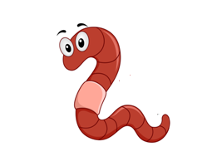
Malware Reverse Engineering
Mencari artifact
Lokasi C&C Server
Keluarga malware
Eksploit yang digunaka
Analisis kelakuan

Slide 22

Exploit Development
Mencari bug yang bisa dieksploitasi
Reversing binary
Diffing patch

Slide 23
Application Pentesting
Mencari artifact
API endpoint
Secret key
Bypass fitur
Memecahkan algoritma dan format data

Slide 24
Karir?

Slide 25
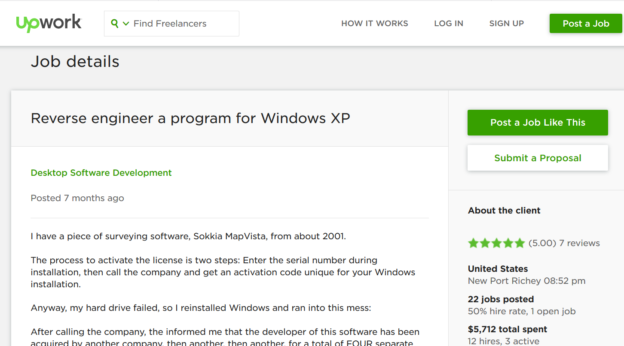
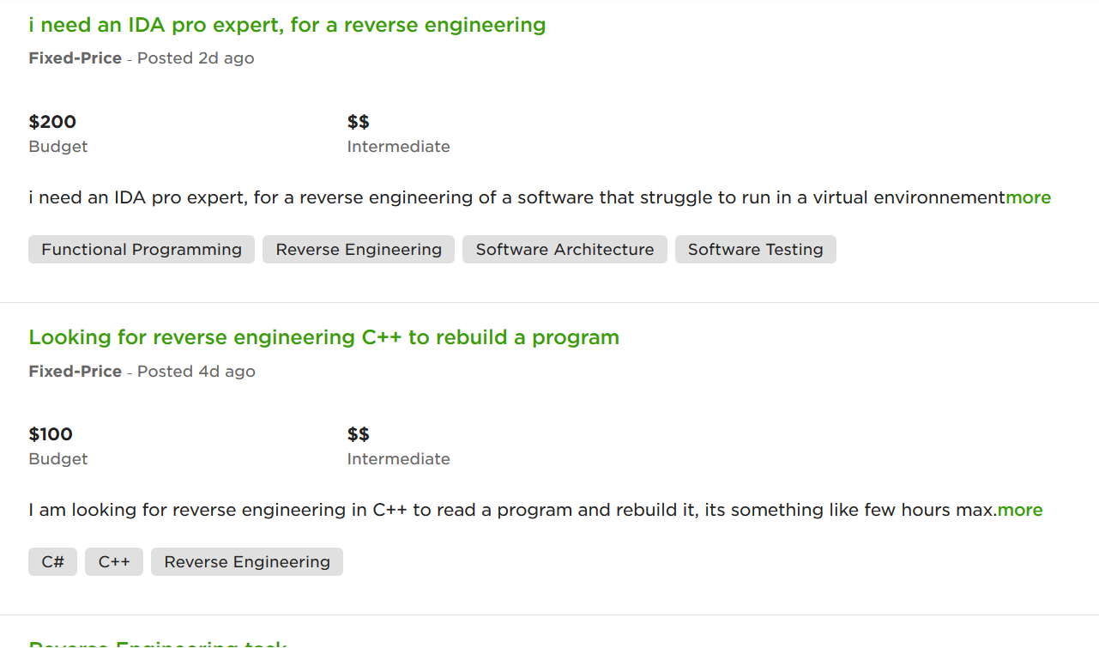

Slide 26
Pekerjaan Tetap?
Malware Reverser pada Endpoint Security
Exploit Developer pada perusahaan security & research
Lihat juga: https://www2.fireeye.com/WBNR-14Q3FLAREWebinar.html

Slide 27
Sertifikasi? Perlu Gak Sih?
GREM | GIAC Reverse Engineering Malware
eCRE | eLearnSecurity Certified Reverse Engineer
CCMRE | CREST Certified Malware Reverse Engineer
CREA | Certified Reverse Engineering Analyst
Sertifikasi membantu evaluasi skill dan mengukur kompetensi

Slide 28
Is Assembly Language Mandatory?
YES
NO
Delphi
JavaScript
MIPS
Java
Python
ARM
PHP
x86
PowerPC
.NET

Slide 29
Do we need …
Cryptography?
Programming?

Slide 30
Tantangan
Kompleksitas
Mengikuti perkembangan teknologi
Language, framework, library
Tools, environment
Paradigm
Mekanisme proteksi (anti analisis)
Hukum

Slide 31
Masa Depan Reverse Engineering?
Automatic Binary Exploitation
Software Verification
Formal Method enhanced with Artificial Intelligence

Slide 32

THANKS
Question?

